Slide 1
The Nervous System
Chapter 5, lesson 2

Slide 2
Vocabulary
Nervous system- a collection of organs that act like the body’s control panel
Brain- an organized grouping of neurons in the head an of animal with bilateral symmetry
Neuron- a nerve cell with a unique structure for receiving and passing on information
Impulse- information that travels as an electrical message
Stimulus- a signal that causes an animal to react in some way
Response- an animal’s reaction to a stimulus

Slide 3
What is the role of the nervous system?
Nervous system- receives information from the environment and coordinates a response.
AKA the bodies control panel
Roles (Jobs) of the Nervous System
1. detect signals in the environment
2. process the signals, and
3. react to them.
Notes:
First you need you need to know what the nervous system is. It is easy to remember as it controls your whole body so think of it as the control center

Slide 4
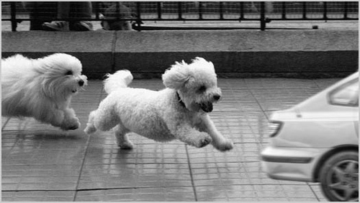
Interactions
Stimulus- a signal from the environment that causes an animal to react in some way
Signals taken in by the 5 senses: Can be touch, sound, smell, taste, or seen.
Response- is an animal’s reaction to a stimulus
Example:
A dog’s ear perks up(response) to the sound of a car coming (stimulus)
Animals can react to stimuli in a matter of a second or the fraction of a second
Notes:
How does the nervous system help our body interact with its environment? The time it takes a dog to hear a car and then respond such as running doesn’t take long at all

Slide 6
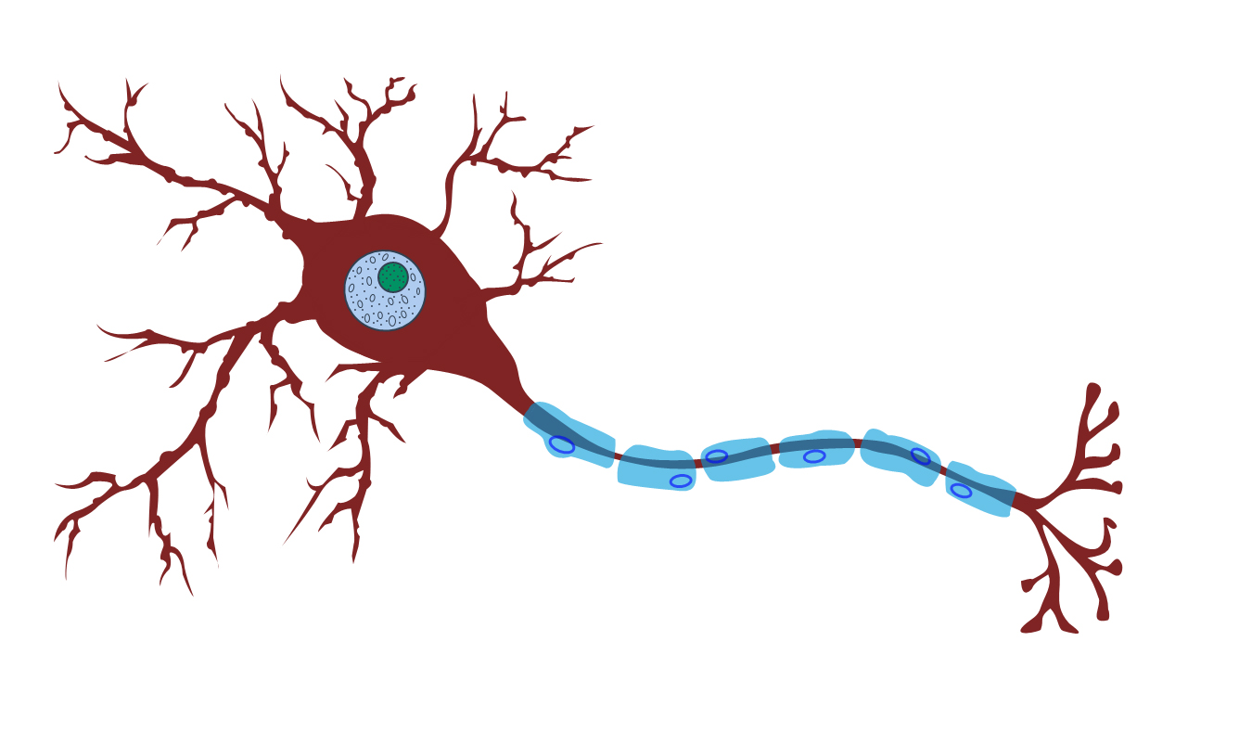
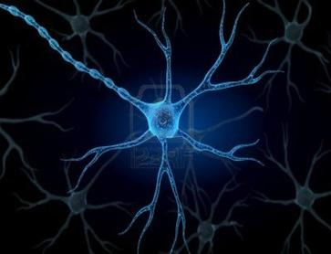
Neurons
The basic unit of the nervous system is the neuron
Neurons enable speedy responses.
A neuron- is a nerve cell with a unique structure for receiving and passing on information.
Impulse- information travels as an electrical message

Slide 7
Types of neurons
Sensory neurons- nerve cells that detect stimuli (the eyes and ears)
Interneurons- are nerve cells that pass information between neurons.
Motor neurons- are nerve cells that carry response information to muscles and other organs. Cause movement! EX: run, jump, punch
Complete the Apply it page 174 & the assess your understanding

Slide 9
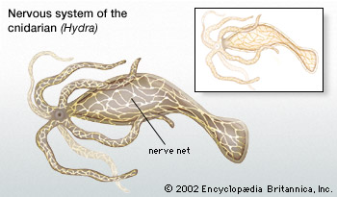
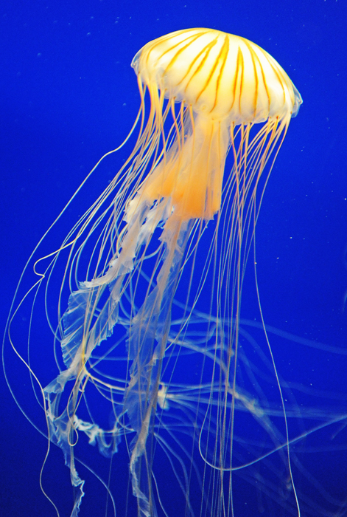
How Do nervous systems differ? Target: I will be able to compare how the nervous systems of animals differ.
Simple Nervous System:
Netlike arrangement of neurons throughout the body
Example: cnidarians (jelly fish, coral)
These animals have NO specialized neurons. Meaning, a stimulus to one neuron sends impulses to all directions.

Slide 10
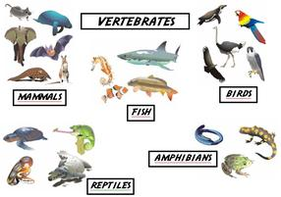
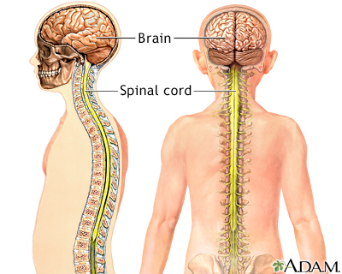
Different Nervous Systems Continued…
Complex Nervous System:
System with a nerve cord and a brain
Example: vertebrates (humans, dogs)
The brain is an organized grouping of neurons in the head of an animal with bilateral symmetry.

Slide 11
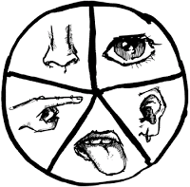
Sense organs
Complex nervous system = more specialized sense organs.
Sense organs are mostly located on your head.(eyes, ears, and nose)
Animals with many sense organs can process many stimuli at the same time.
**those 5 senses**
Complete pages 176 & 177. In figure 2, read about each animal then answer the questions. When done, move on to the assessment questions.
Notes:
You are complex so you can “sense” multiple things at once.

Slide 12
Hydra- Netlike nervous system in action

Slide 13
Reminder!
Lesson 2 textbook pages are due next Wednesday. The 16th. Pages 172-177

