Slide 1
Development & Growth
Chapter 5 lesson 6

Slide 2
Vocabulary

Slide 3
Where do embryos develop?
Multiple animals reproduce sexually, but after fertilization, the offspring of these animals may develop in different ways.
KEY CONCEPT: The growing offspring, or embryo, may develop outside or inside of the parent’s body.

Slide 4
Egg-laying animals
The offspring of some animals develop inside an egg laid outside of the parent’s body.
The eggs of land vertebrates, such as reptiles and birds, are called amniotic eggs.
Amniotic eggs are covered with membranes and a leathery shell while still inside the parent’s body.
Notes:
What would happen if fish eggs were laid on land? (they’d dry out) Which 2 groups of vertebrates produce shelled eggs? (reptiles & birds) Why is the shelled egg important? (it allows the offspring to grow and develop without drying out)

Slide 5
Amniotic egg
Notes:
What is the developing offspring called when it is inside the egg? (an embryo)

Slide 6
Placental Mammals
In dogs, horses, humans, and other placental mammals, the embryo develops inside the mother’s body.
The mother provides the embryo with everything it needs during development.
Materials are exchanged between the embryo and the mother through an organ called the placenta.

Slide 7
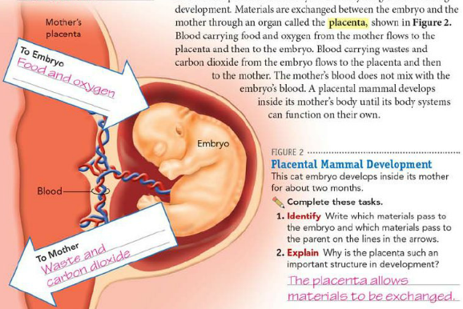
Placental Mammal Development
Notes:
Where can embryos develop? (inside or outside the parent’s body)

Slide 8
How do young animals develop?
A lot of animals grow and change throughout their lifetime, but just look like small versions of adults.
KEY CONCEPT: Young animals undergo changes in their bodies between birth and maturity, when they are able to reproduce.
Notes:
Can you name some animals whose offspring look a lot like the adults? (cats, dogs, turtles, horses, etc)

Slide 9
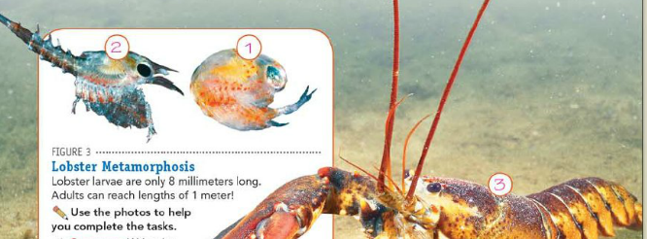
Crustaceans
Lobsters, crabs, and shrimp begin their lives as tiny larvae. The bodies of these larvae DO NOT resemble those of the adults.
Eventually, through metamorphosis, crustacean larvae develop into adults.

Slide 10
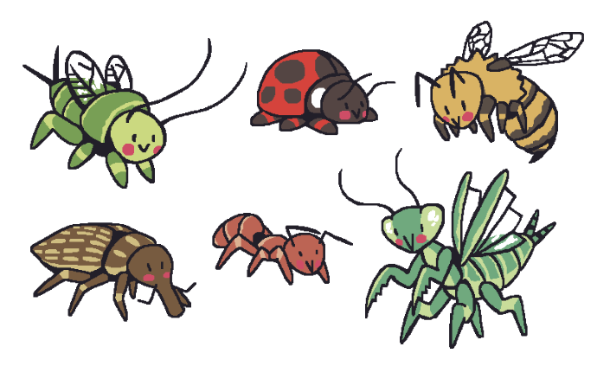
Insects
After an insect hatches from an egg, it begins metamorphosis as it develops into an adult.
Insects such as butterflies, beetles, and grasshoppers undergo complete or incomplete metamorphosis.

Slide 11
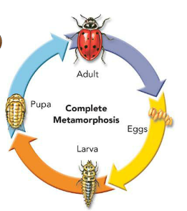
Complete metamorphosis
Has 4 stages: egg, larva, pupa, and adult
Just because the pupa seems inactive, it is actually very active. The body is changing from the larva form to an adult. Toward the end of the pupa stage, the pupa may appear to wiggle as the insect inside moves.
Notes:
What is a larva? (an immature form of an adult) What is a pupa?(a stage in which the insect is enclosed in a protective covering when it changes into the adult form)

Slide 12
Metamorphosis of a butterfly
PUPA- CHRYSALIS IS MADE-DEVELOPING INTO ADULT
LARGER
LARVA
EGGS
ADULT
SMALL
LARVA
Notes:
What is the first stage of complete metamorphosis? (egg) What is the name for the larva of a butterfly? (caterpillar) What structures develop while the insect is in the pupa stage? (wings, legs, antennae)

Slide 13
Incomplete metamorphosis
has no distinct larval stage.
3 stages: egg, nymph, and adult.
The nymph usually looks like the adult without wings. As it grows, it may outgrow its exoskeleton several times before becoming an adult.
Notes:
What is it called when an animal sheds its exoskeleton? (molting)

Slide 14
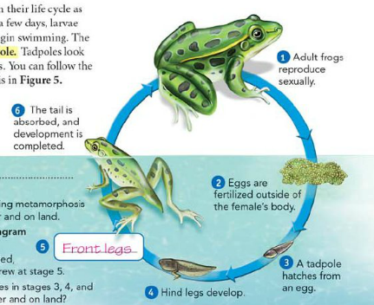
Amphibians
Frogs begin their life cycle as fertilized eggs in water.
After a few days, larvae wriggle out of the eggs and begin swimming.
The larva of a frog is called a tadpole.
Tadpoles look very different from adult frogs.

Slide 15
How do animals care for their young?
KEY CONCEPT: Most amphibians and reptiles do not provide parental care, while most birds and mammals typically care for their offspring.

Slide 16
No parental care
Not all animals take care of their young.
Most aquatic invertebrates, fishes, and amphibians release many eggs into water and then completely ignore them!
Most amphibian larvae, or tadpoles, develop into adults without parental help.
Offspring that do not receive parental care must be able to care for themselves from the time of birth.
Notes:
What do you think happens to the offspring with no parental care? (eaten by predators.)

Slide 17
Parental Care
Most birds and all mammals typically spend weeks to years under the care and protection of a parent.
Birds: Most birds feed and protect their young until they are able to care for themselves.
Mammals: Young mammals are usually quite helpless for a long time after they are born. After birth, all young mammals are fed with milk from the mother’s body.
Notes:
Which groups of vertebrates usually care for their young? (birds & mammals) How do you think this affects the survival of the offspring? (if they are protected and cared for, they are more likely to survive.)

Slide 18
Parental Care
Mammals
Birds

