Slide 1
The sky from earth
Chapter 10 Lesson 1

Slide 2
Vocabulary
Satellite- a body that orbits a planet
Planet- an object that orbits the sun, is large enough to have become rounded by its own gravity, and has cleared the area of its orbit
Meteor- the streak of light that is produced when a small object burns up entering the Earth’s atmosphere
Comet- a cold mixture of dust and ice that gives off a long trail of light as it approaches the sun
Star- a giant ball of hot gas, mainly composed of hydrogen and helium
Constellation- a pattern or group of stars that people imagined to represent a figure, animal, or object

Slide 3
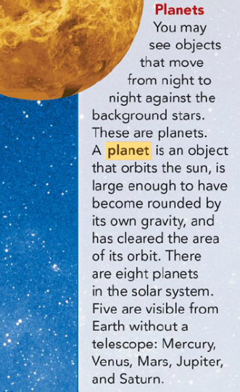
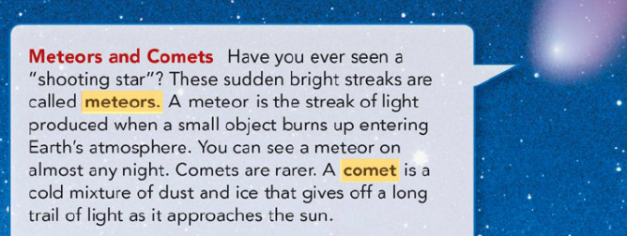
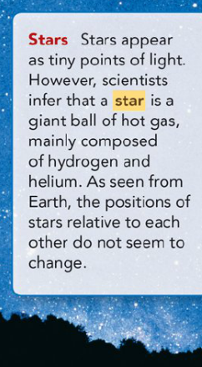
What can you see in the night sky?

Slide 4
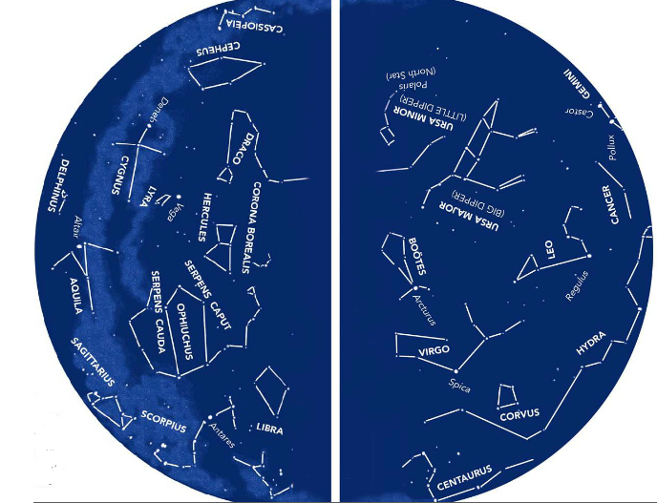
Constellations
A constellation is a pattern or group of stars that people imagined to represent a figure, animal, or object
There are 88 constellations acknowledged in Western cultures
Most constellations names used today come from the ancient Greeks
A star chart can help you find constellations in the night sky
https://www.youtube.com/watch?v=BbzCA0Lgf3Y&t=92s

Slide 5
How do objects in the sky appear to move?
STARS MOTION
Earth turns from west to east (just like you will!)
Therefore, the stars appear to move from east to west
SEASONAL CHANGES
The constellations and star patterns that are visible vary from season to season
Seasonal changes are caused by the Earth’s orbit around the sun
Each night, stars shift slightly to the west
PLANETS
Planets appear to move against the background of stars
Planets appear move through a narrow band in the sky
This band is known as the zodiac
Mercury, Venus, Mars, Jupiter, and Saturn are visible from Earth without a telescope

