Slide 1
TIDES
Chapter 10-Lesson 3

Slide 2
TIDES: VOCABULARY
Tide: the rise and fall of ocean water
Spring tide: the tide with the greatest difference between consecutive* low and high tides
Neap tide: the tide with the least difference between consecutive* low and high tides
*consecutive- following continuously ex: You go to school 9 consecutive months out of the year.

Slide 3
KEY QUESTION: WHAT ARE TIDES? Pg 409
Tides, the rise and fall of ocean water, occurs every 12.5 hours or so.
Gravity pulls the moon and Earth, including the water on Earth’s surface, toward each other.
Key Concept Part 1: Tides are caused mainly by differences in how much gravity from the moon and the sun pulls on different parts of Earth.
At any one time on Earth, there are two places with high tides and two places with low tides.
Notes:
How does the moon cause a high tide? (the force of gravity from the moon pulls on Earth. The water on the side of Earth facing the moon is pulled toward the moon more strongly than the rest of the Earth. The water on the other side of Earth is pulled least of all, and is left behind. This produces “bulges” of water.

Slide 4
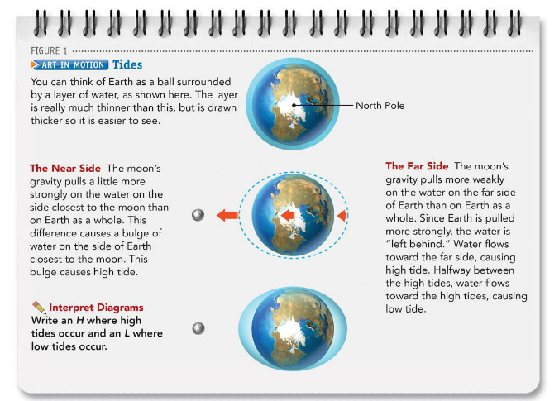
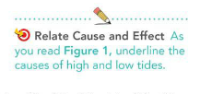
Open book to Pg 409 Figure 1
Science involves many
cause-and-effect relationships.
A cause makes something happen.
An affect is what happens. When
you notice that one event causes
another, you are relating cause
and effect.
Notes:
What are the 2 ways Earth moves? Which of these do you think effects the tide cycle? (rotation) How? (as it rotates, on high tide stays on the side of Earth facing the moon.)

Slide 5
The Sun’s Role Pg 410
Although the sun is far away from Earth (93 million miles AWAY!), it is so massive that its gravity affects the tides.
Key Concept Part 2: Changes in the positions of Earth, the moon, and the sun affect the heights of the tides during a month.
Notes:
What did we say affects gravity? (mass and distance) so even though it is so far away, its so massive that its gravity still affects Earth.

Slide 6
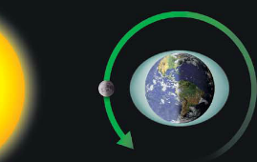
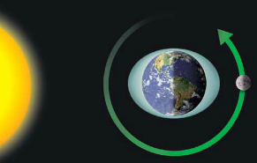
Continued… Pg 410
The New Moon/Full moon- the sun, Earth, and moon are nearly in a line. The gravity of the sun and the moon pull in the same direction.
Their combined forces produce a tide with the greatest difference between consecutive low and high tides. This is called a spring tide.
← New Moon
Full Moon →
Notes:
This alignment allows for the greatest gravitational pull

Slide 7
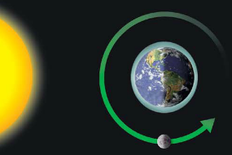
Continued… Pg 410
First Quarter/Third Quarter- The line between the Earth, moon, and sun create a right angle, 90◦.
This arrangement produces a neap tide, a tide with the least difference between consecutive low and high tides.
Neap tides occur twice a month.
Notes:
The angle of 90 weakens the gravitational pull.

Slide 8
https://youtu.be/cm7T1Etl2XY?t=18s
Notes:
summary

Slide 9
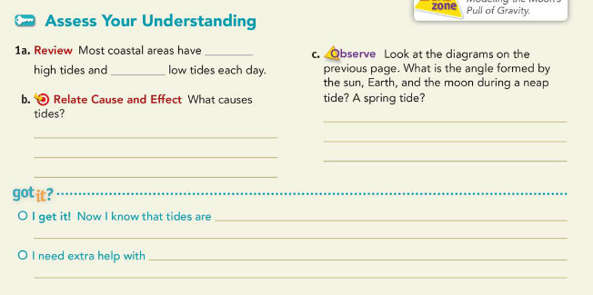
Turn book to Pg 411 and answer the assess your understanding and get out your INB and rate yourself for lesson 5
Notes:
How can you combine key concept part 1 & 2 to answer the I get it?

Slide 10
Group Work
Finish the rest of pages 410 & 411

